Slide 1

Freddie Mac Single Family Loan Dataset Assessment Output
Arjun Dayal Mishra, MS

Slide 2
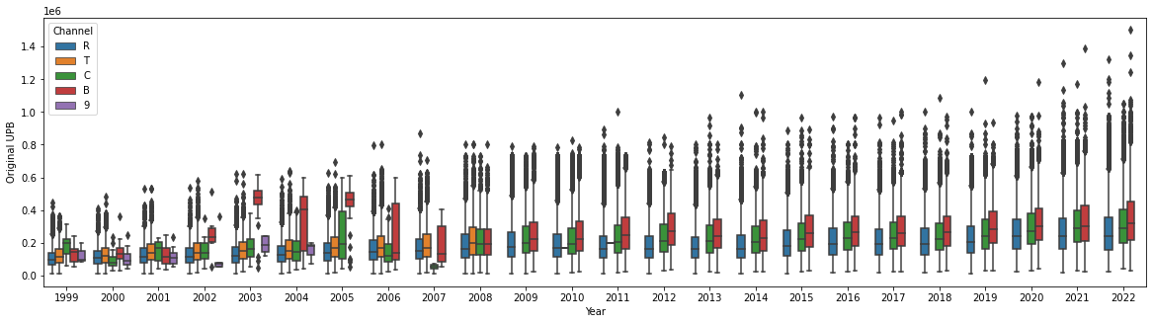

Through charting boxplots based on unpaid balance against Occupancy Status
It is evident that Investment properties are usually bought by the segment which has higher personal yield and purchasing power.
Can this be translated into a section which can be targeted for Private Bank products? Further classification of this segment can help better the sales strategies and have a higher acquisition rate.

Slide 3
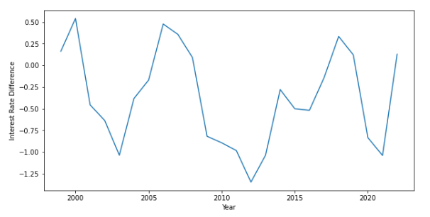
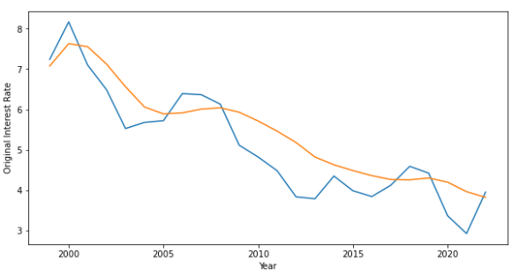
Periodic sinusoidal chart of interest rate difference between original value and current value
As evident from the graph, the difference between original and current interest rates of mortgages is going to hit its peak in the next two years and will then subsequently fall. Does this mean holding a short position on our client’s asset allocation will yield better short-term growth?

Slide 4

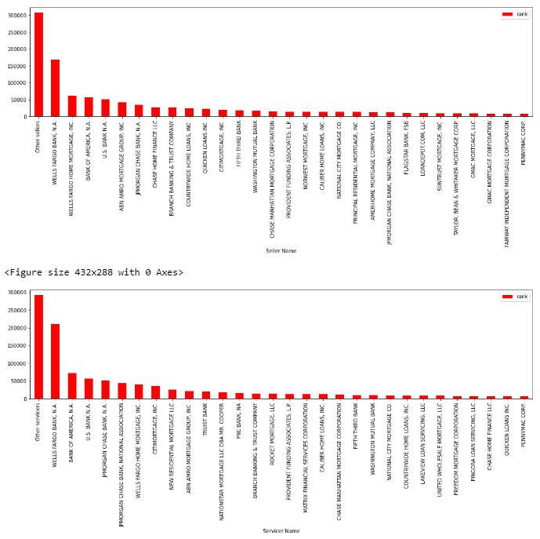
Seeing that Wells Fargo is the single highest Mortgage seller and servicer for Freddie Mac, are there any advantages they are privy to that other sellers/servicers are not? Are they being incentivized to do so? What is their advantage over others?
Subtitle

Slide 5


Thank You

